Slide 1

Cyber Threat Intelligence Complete Course
By: Deepanshu Khanna

Slide 2
Introduction
CTI is the analyzed information about an adversary’s intent, capabilities, and opportunity to compromise a target. It’s produced from various data points and serves decision-makers.
Analyse the Adversary:
Who is attacking (e.g., APT28, FIN7)
Why (espionage, financial gain)
How (phishing, zero-days)
Where from (infrastructure, domains)
When (timeline of operations)
From the Perspective of the Client (Consumer-Oriented CTI):
Client Type | Intelligence Need | CTI Example
SOC Analyst | IOC feed + detection rules | Hashes, domains, Sigma rules for current malware campaigns
Threat Hunter | Adversary TTPs and historical campaign analysis | MITRE mappings for APT10; hunting queries for beaconing traffic
Executive/CISO | Strategic threat landscape overview | High-level threat report on ransomware trends and risks for Q3
IR Team | Attribution, malware reverse engineering | Malware family identification, attack vector analysis
Government/LE | Actor attribution, geopolitical implications | CTI on nation-state campaigns (e.g., SolarWinds, Moonlight Maze)

Slide 3
Introduction to CTI Contd..
CTI
Cyberspace
Threats
Intelligence
Notes:
1. Cyberspace: The Operating Terrain of CTI
Cyberspace is the domain in which all cyber threat activities take place. It is composed of multiple interlinked layers:
▪️ Physical Layer:
Definition: Tangible components of networks and infrastructure.
Examples:
Routers, switches, servers, network cables, data centers
An attacker physically tampers with a router or uses RF attacks on wireless routers (like WiFi Pineapple).
▪️ Logical Layer:
Definition: Non-physical elements such as applications and protocols.
Examples:
Operating systems, browsers, cloud services, communication protocols.
Exploiting Apache Log4j vulnerability in a cloud-based application represents a threat at this layer.
▪️ Information Layer:
Definition: Actual data – what the attacker targets or manipulates.
Examples:
Emails, chat messages, documents, databases.
Phishing emails that trick users into entering credentials or open weaponized documents (macro-laden Word files).
---
2. Threat: The Actor and Their Intent
A threat is defined as intention + capability + opportunity
Intention (Why):
Definition: The motive or objective of the adversary.
Examples:
Cybercriminals want money → deploy ransomware (e.g., LockBit)
Nation-states seek espionage → target diplomatic emails
Hacktivists want to disrupt → deface websites
---
🛠️ Capabilities (How):
Definition: Tools, tactics, techniques, and procedures (TTPs) used.
Examples:
Malware (e.g., Cobalt Strike, Mimikatz)
Exploits (e.g., CVE-2021-44228 – Log4Shell)
TTPs mapped to MITRE ATT\&CK (e.g., T1059 – Command Scripting)
---
🕳️ Opportunity (Where & When):
Definition: Weakness or entry point that allows the threat to exploit.
Examples:
Misconfigured firewalls
Unpatched vulnerabilities
Users falling for phishing campaigns
---
3. Intelligence: From Data to Decision
> Intelligence is processed, validated, analyzed, and actionable information. CTI exists to serve decisions.
Primary Goal:
Facilitate the decision-making process for defenders, CISOs, SOC teams, executives, or law enforcement.

Slide 4
CTI Life Cycle
Planning and Direction
Processing
Analysis and Production
Collection of data
Dissemination
Notes:
CTI Lifecycle (with Examples)
1. Planning and Direction
Definition: Define the questions CTI must answer.
Examples:
“Which APT groups are targeting the financial sector?”
“What are the TTPs of Medusa ransomware?”
---
2. Collection
Definition: Gather raw data from various sources.
Examples:
OSINT: Pastebin dumps, Twitter IOCs
Internal logs: SIEM, firewall, EDR
Dark web scraping
---
3. Processing
Definition: Structure and format data for analysis.
Examples:
Parsing IOC feeds (convert into STIX or JSON)
Deobfuscating malware strings
---
4. Analysis and Production
Definition: Turn processed data into actionable intel.
Examples:
“APT29 uses spear-phishing to drop WellMess malware in government orgs”
Map adversary's infrastructure using passive DNS
---
5. Dissemination
Definition: Deliver the intel to the right consumer in a useful format.
Examples:
Threat reports (PDF, STIX)
Dashboards (OpenCTI, MISP)
Alerts to SOC analysts via SIEM

Slide 5
CTI: Key Terminologies
Threat Actor
Persona
Intelligence Requirements
Campaigns
Tactics, Techniques, and Procedures (TTP)
Intrusion
Traffic Light Protocol (TLP)
Indicator of Compromise (IOC)
A person, group, or nation-state responsible for malicious cyber operations.
The online identity or alias used by a threat actor to remain anonymous.
Questions or needs that guide the collection and analysis of threat intelligence.
A coordinated series of malicious activities aimed at a long-term objective.
TTP analysis helps in actor profiling, defense hardening, and hunting queries.
Any attempt by an adversary to compromise a system, whether successful or not.
A color-coded system for managing information sharing boundaries within and across organizations.
A technical artifact linked to malicious activity, especially useful for detection and hunting.
Notes:
🎭 1. Threat Actor
Definition: A person, group, or nation-state responsible for malicious cyber operations.
Types of Threat Actors:
TypeDescriptionExample
--------------------------------------------------------------------------------------------------------
CybercriminalsFinancially motivated; engage in ransomware, fraud, etc. LockBit, Conti
APT GroupsNation-state or state-sponsored; focus on espionage, sabotageAPT28 (Russia), APT10 (China)
Hacktivists Ideologically motivated; deface, leak, or disrupt for a causeAnonymous, LulzSec
Script KiddiesAmateur attackers using pre-made tools without deep knowledgeDefacing school websites
---
🧑‍💻 2. Persona
Definition: The online identity or alias used by a threat actor to remain anonymous.
Context:
Used in dark web forums, Telegram, or initial access markets.
Helps CTI teams track behaviors and link aliases across platforms.
Example:
A ransomware operator uses the persona "ShadowSpider" on multiple RaaS forums.
---
📋 3. Intelligence Requirements (IRs)
Definition: Questions or needs that guide the collection and analysis of threat intelligence.
Purpose: To ensure intelligence is client-driven, targeted, and relevant.
Examples:
What TTPs are associated with the latest LockBit 3.0 campaign?
Have any Russian APTs been observed targeting Latvia in the past 6 months?
📌 Best Practice: Define IRs during the Planning & Direction phase of the intelligence cycle.
---
🎯 4. Campaign
Definition: A coordinated series of malicious activities aimed at a long-term objective.
Key Traits:
Multiple operations (phishing, malware deployment, C2 communication).
May span weeks to years.
Example:
APT33 launching multiple spear-phishing attacks targeting Middle Eastern oil companies over 18 months — part of a larger campaign for economic espionage.
---
⚔️ 5. TTPs – Tactics, Techniques, and Procedures
Term DescriptionExample
------------------------------------------------------------------------------------------------------------------------------------------------------------
Tactic The high-level objective or phase of the attack Initial Access, Execution, Persistence (MITRE ATT\&CK Tactics)
Technique The method used to achieve the tactic Spear-phishing (T1566), Credential Dumping (T1003)
Procedure The specific implementation of the technique Sending a malicious PDF via email spoofed from [HR@targetcorp.com](mailto:HR@targetcorp.com)
🔍 Use: TTP analysis helps in actor profiling, defense hardening, and hunting queries.
---
🚨 6. Intrusion
Definition: Any attempt by an adversary to compromise a system, whether successful or not.
Importance:
Even failed intrusions provide valuable IOCs, TTP patterns, and threat insights.
Should be logged, correlated, and analyzed for trend detection.
Example:
Multiple failed brute-force attempts on an SSH service → could indicate a larger scan-and-exploit operation.
---
🟢 🔴 7. Traffic Light Protocol (TLP)
Definition: A color-coded system for managing information sharing boundaries within and across organizations.
TLP Color Information Sharing Boundaries When to Use How to Share
----------------- -------------------------------------------------------- --------------------------------------------------- -----------------------------------------
TLP\:REDRestricted to specific individuals or groups Sensitive info impacting privacy, safety, or operations DO NOT share outside original recipients
TLP\:AMBERLimited disclosure within recipient’s organization onlyMay impact operations if shared widely Internal use only
TLP\:AMBER+STRICT Only with specified partners Custom sharing restriction to subset partners By agreement only
TLP\:GREENShare with peer organizations in the community Valuable for community defense Peer and trusted partner sharing allowed
TLP\:WHITEPublicly shareable No risk in disclosure May publish or post
🔗 [More info on TLP](https://www.first.org/tlp/)
---
🧬 8. IOC – Indicator of Compromise
Definition: A technical artifact linked to malicious activity, especially useful for detection and hunting.
IOC Type Examples
---------------------------------------------------------------
Hashes `d41d8cd98f00b204e9800998ecf8427e` (MD5), SHA256
IP Addresses `45.129.200.31` (C2 IP)
URLs/Domains `malicious-site[.]ru`, `update-google[.]com`
File Names `invoice.docm`, `payload.exe`
Email Addresses`hr-dept@targetcorp.com`
Registry Keys`HKCU\Software\BadMalware\Persistence`
⚙️ Best Use:
Feed into SIEM, EDR, firewall, or YARA/Sigma detection systems.

Slide 6
CTI Models
Cyber Kill Chain
MITRE ATT&CK
Pyramid of Pain
Diamond Model
Notes:
CTI Lifecycle (with Examples)
1. Planning and Direction
Definition: Define the questions CTI must answer.
Examples:
“Which APT groups are targeting the financial sector?”
“What are the TTPs of Medusa ransomware?”
---
2. Collection
Definition: Gather raw data from various sources.
Examples:
OSINT: Pastebin dumps, Twitter IOCs
Internal logs: SIEM, firewall, EDR
Dark web scraping
---
3. Processing
Definition: Structure and format data for analysis.
Examples:
Parsing IOC feeds (convert into STIX or JSON)
Deobfuscating malware strings
---
4. Analysis and Production
Definition: Turn processed data into actionable intel.
Examples:
“APT29 uses spear-phishing to drop WellMess malware in government orgs”
Map adversary's infrastructure using passive DNS
---
5. Dissemination
Definition: Deliver the intel to the right consumer in a useful format.
Examples:
Threat reports (PDF, STIX)
Dashboards (OpenCTI, MISP)
Alerts to SOC analysts via SIEM

Slide 7
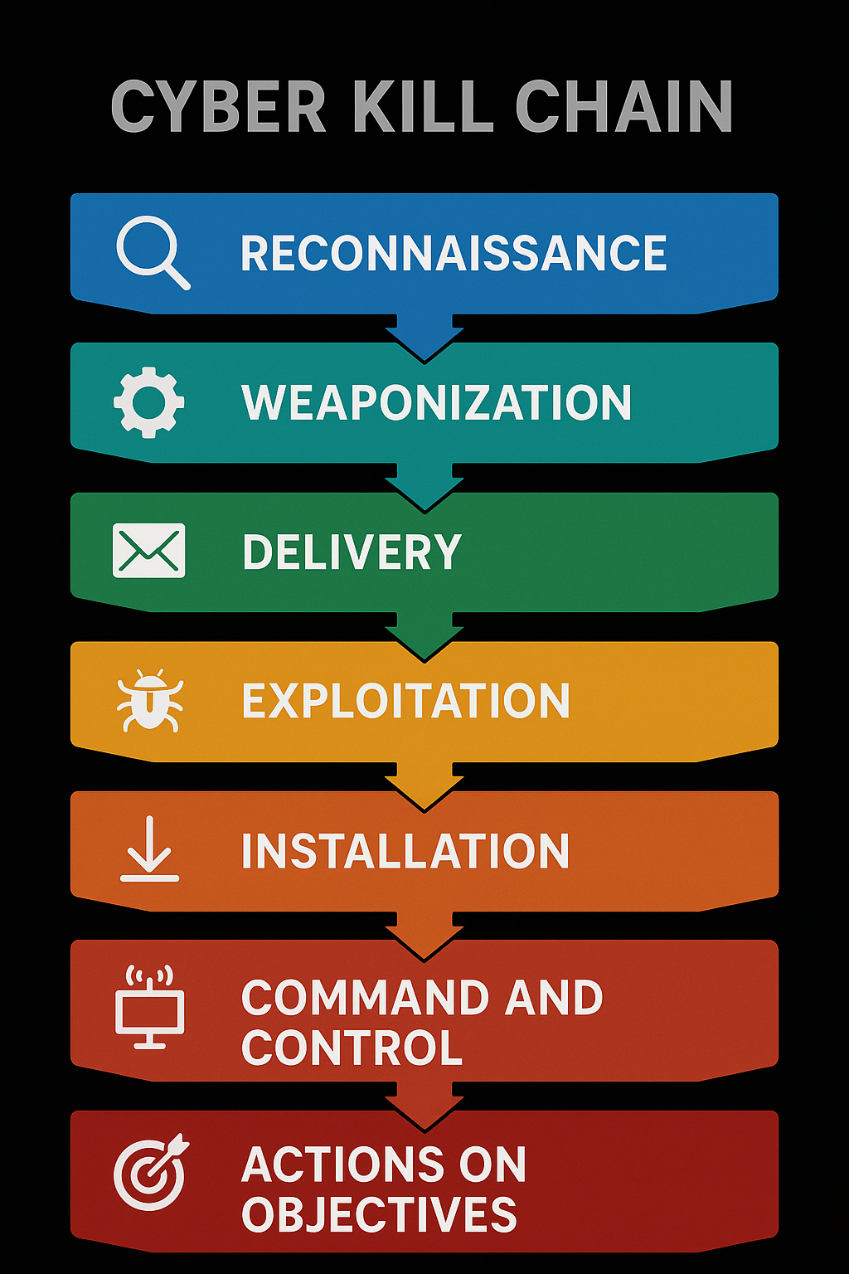
CTI Models: Cyber Kill Chain
Developed by: Lockheed Martin
Purpose: Map the stages of a cyber intrusion to detect and disrupt at each stage
Goal for defenders: Stop the intrusion as early as possible (before “Actions on Objectives”)
Real-Life Example: Emotet Intrusion
Recon: Collected target org emails (e.g., through prior phishing)
Weaponization: Packed macro-enabled Word doc
Delivery: Spear-phishing with invoice-themed email
Exploit: User enables macros
Install: Emotet downloader installs TrickBot
C2: Beacons to hardcoded C2 IP
Action: Data theft, ransomware deployment (Ryuk)
Stages
Stage | Description | Example
Reconnaissance | Adversary collects data about the target | Scanning for open ports
Weaponization | Malware or exploit package creation | Creating a malicious PDF exploit
Delivery | Transmission to victim | Spear-phishing email with payload
Exploitation | Triggering the vulnerability | User opens malicious attachment
Installation | Malware installs a backdoor | Dropper installs remote access tool
Command & Control (C2) | Attacker establishes remote control | Malware connects to C2 server
Actions on Objectives | Executes final goal(data theft destruction) | Data exfiltration to attacker server

Slide 8
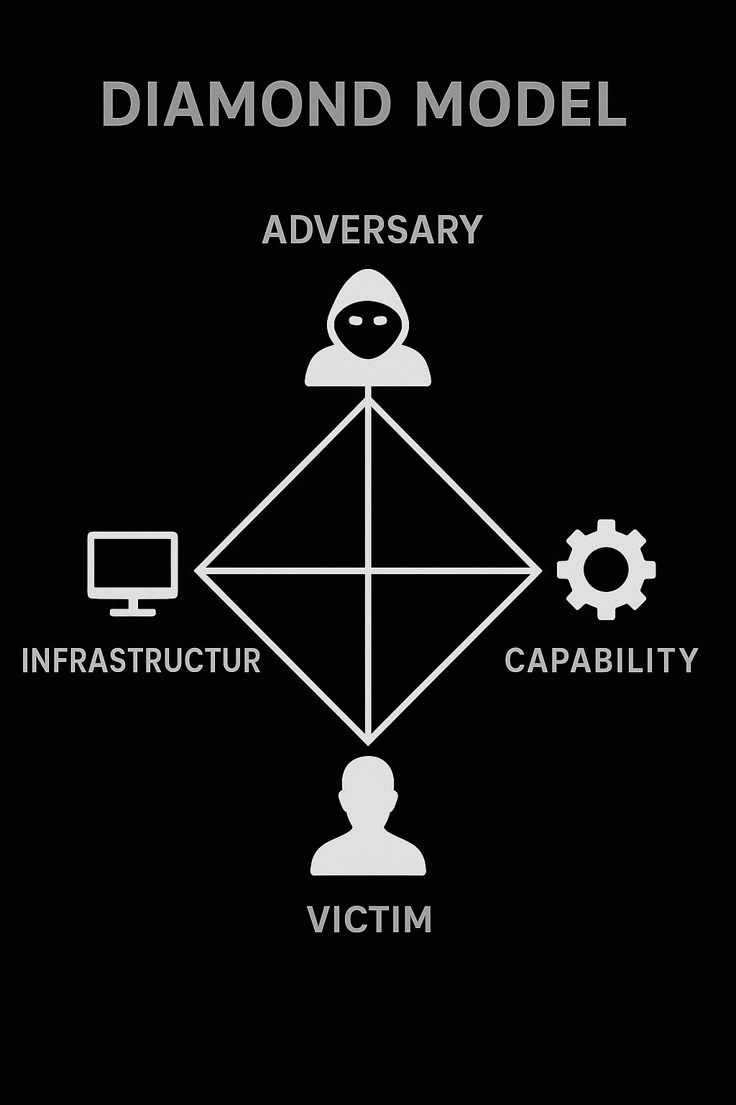
CTI Models: Diamond Model
Developed by: Caltagirone, Pendergast & Betz (2007)
Purpose: Analyze relationships between adversary, capability, infrastructure, and victim
Core Elements:
Adversary – Threat actor or group (e.g., APT28)
Infrastructure – C2 domains, compromised servers (e.g., `mail-login[.]ru`)
Victim – Targeted entity (e.g., Government of Ukraine)
Capabilities – Malware, exploits (e.g., X-Agent, spear phishing)
Real-Life Example: APT28 Attack
Adversary: APT28 (Fancy Bear)
Infrastructure: Domains like `update[.]office365portal[.]ru`
Victim: NATO defense contractors
Capability: Spear-phishing with macro-laced DOCX, X-Agent malware
Use in CTI:
Helps in attribution, tracking campaigns, and pivoting (e.g., reuse of infrastructure across victims)

Slide 9
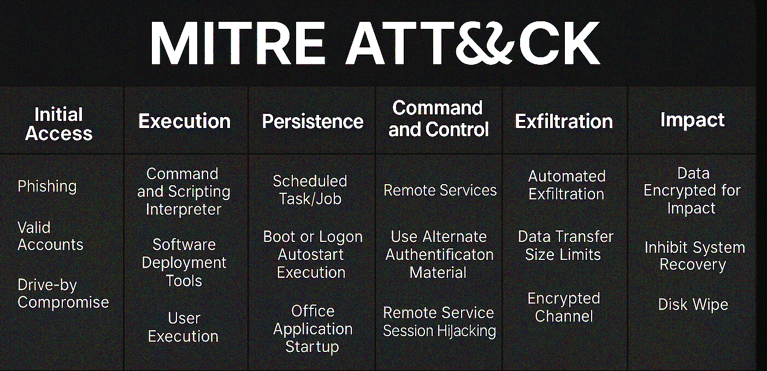
CTI Models: MITRE ATT&CK Model
Maintained by: MITRE Corporation
Purpose: Taxonomy of real-world adversary behaviors and TTPs
Public Resource: [https://attack.mitre.org/](https://attack.mitre.org/)
Structure:
Tactics: Why (objective)
Techniques: How (method)
Sub-techniques: Specific implementations
Use in CTI:
Track adversary trends (e.g., “APT29 heavily uses T1059.001”)
Map threat reports or SIEM alerts to known techniques
Help defenders write Sigma/YARA rules aligned with known TTPs
Toolkits:
MITRE ATT\&CK Navigator
Threat Mapping in MISP / OpenCTI
TTP
Tactic | Technique | Sub-technique
Initial Access | Phishing (T1566) | Spearphishing Attachment (T1566.001)
Execution | Command and Scripting | PowerShell (T1059.001)
Persistence | Registry Run Keys (T1547) | —
Defense Evasion | Obfuscated Files (T1027) | —
C2 | Application Layer Protocol | HTTPS (T1071.001)

Slide 10
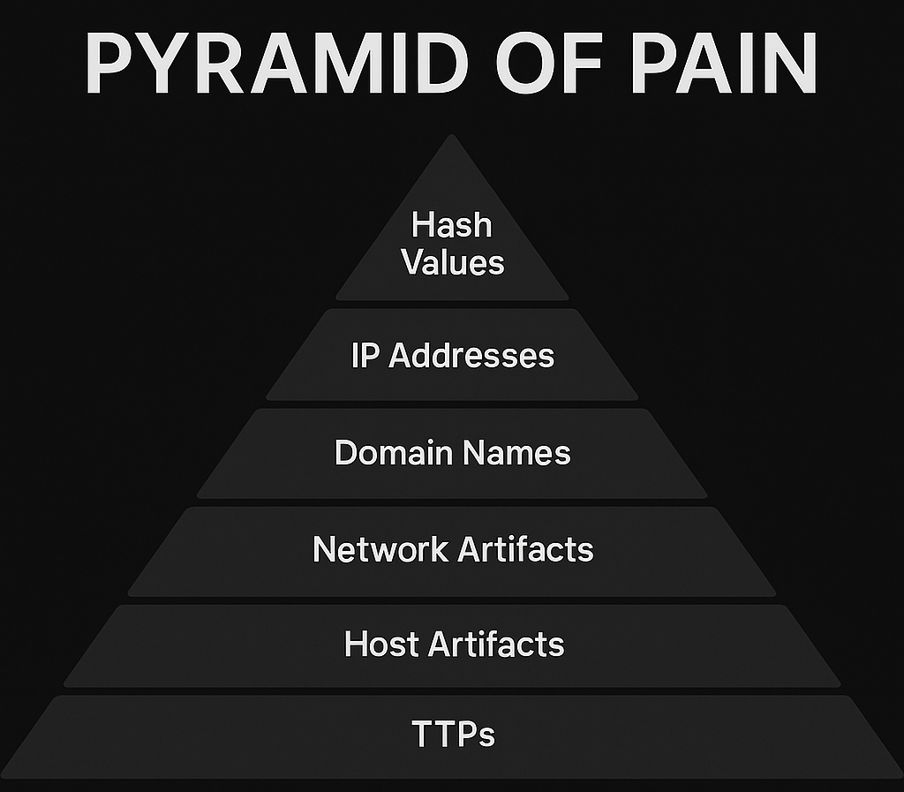
CTI Models: Pyramid of Pain
Created by: David Bianco
Purpose: Demonstrates the difficulty (and impact) of detecting different indicators
Use Case:
Focus on detecting TTPs (e.g., lateral movement via `wmic`) rather than just static IPs
YARA rules and behavioral analytics help hit the top of the pyramid
Better long-term defense
Structure (from bottom to top)
Level | Description | Pain for Adversary
Hash Values | Specific file fingerprints | 🟢 Low
IP Addresses | C2, exfil points | 🟢 Low
Domain Names | Short-lived, disposable | 🟡 Moderate
Host Artifacts | Registry keys, file paths | 🟡 Moderate
Tools | Malware families, frameworks (Cobalt) | 🔴 High
TTPs | Behavioral patterns | 🔴🔴 Very High

Slide 11
CTI Models: Summary Table
CTI Models Comparison
Model | Focus | Best For
Cyber Kill Chain | Stages of an intrusion | Incident response, detection strategy
Diamond Model | Relation between actor/infrastructure/capabilities/victim | Attribution, campaign tracking
MITRE ATT\&CK | Adversary TTPs in matrix format | Threat hunting, red teaming, blue teaming
Pyramid of Pain | Detection value of indicators | Prioritizing IOC hunting, proactive defense

Slide 12
CTI Models: Primo Analysis Demo
(APT-36)

Slide 13
Thanks

